Slide 1
BANKING MANAGEMENT SYSTEM USING PHYTHON & SQL
Shubam Bopche
Manasa Kumari Varkala
G.Rajashekar Reddy

Slide 2
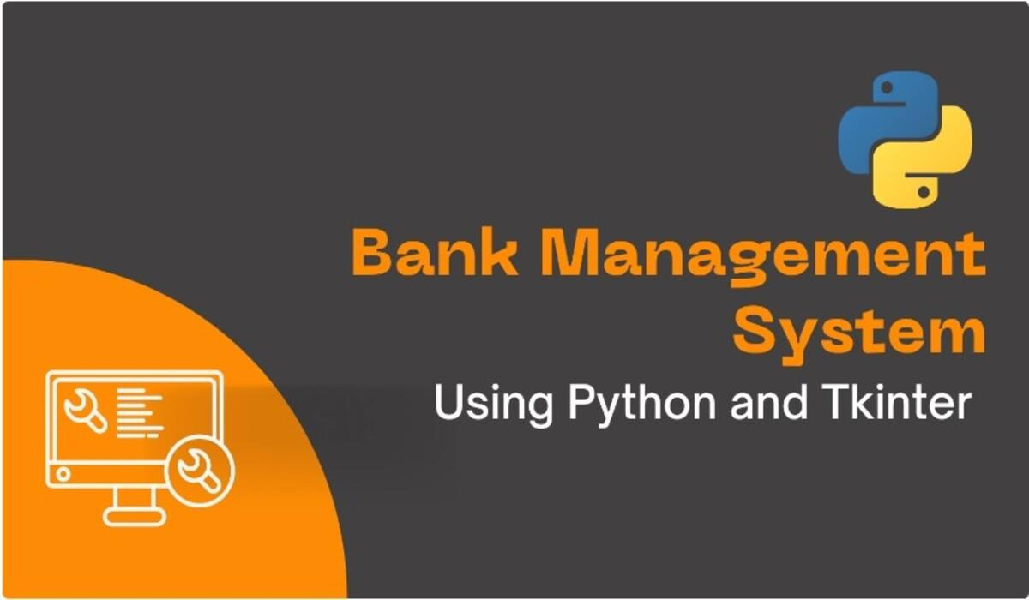

Slide 3
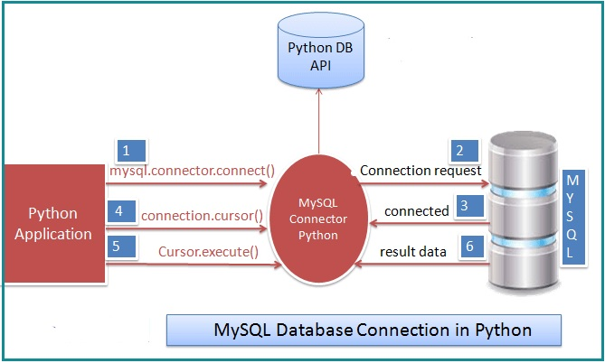

Slide 4
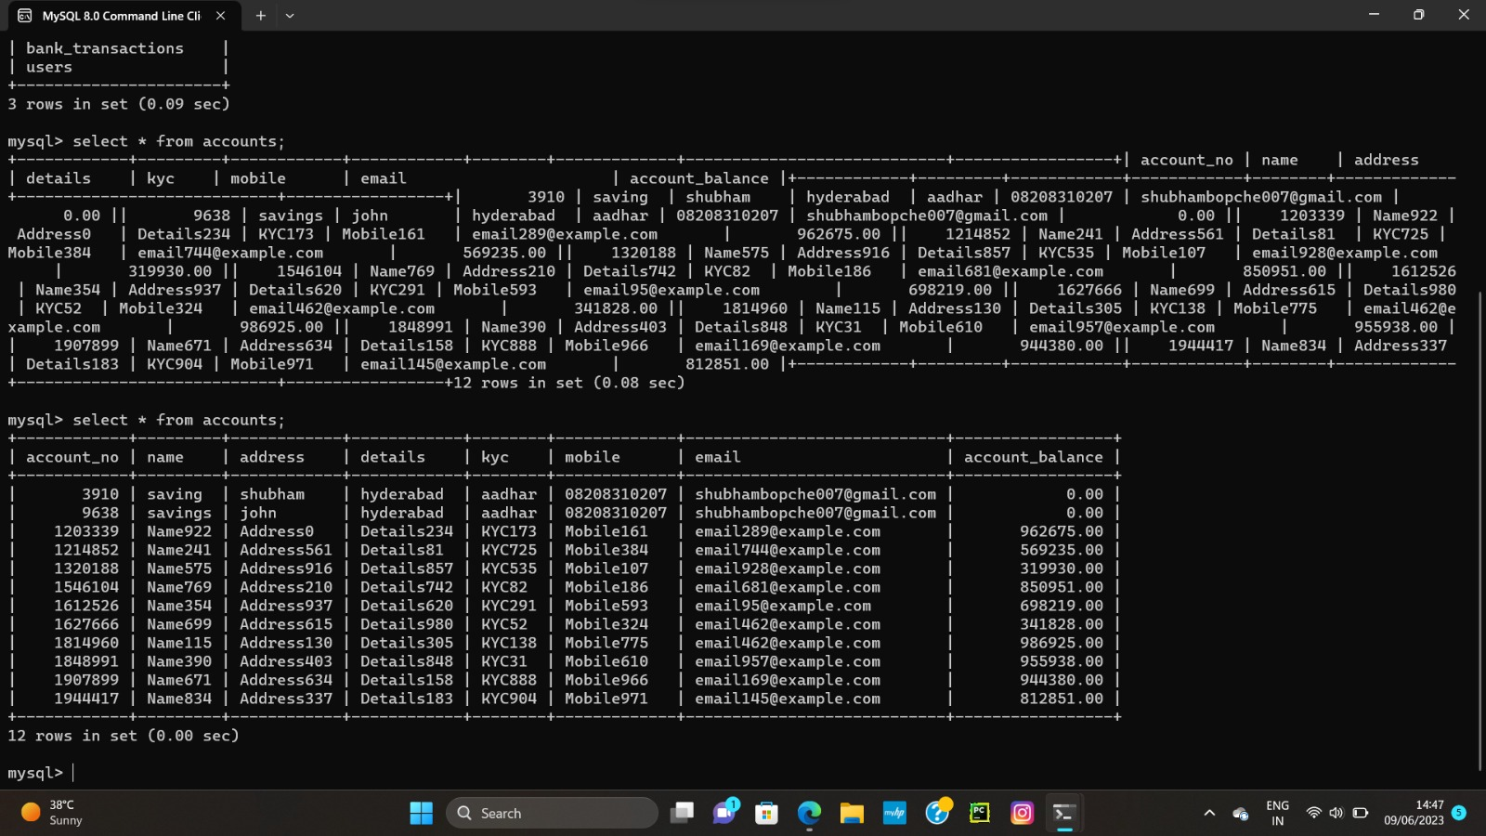
Data stored in SQL

Slide 5
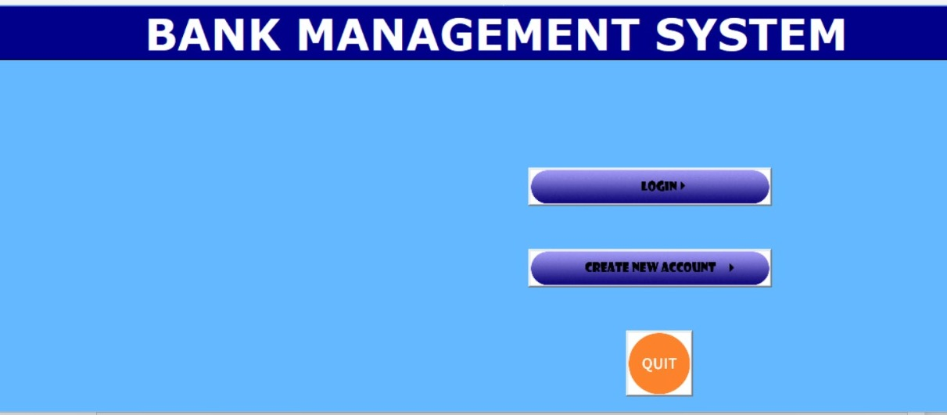
User Interface

Slide 6
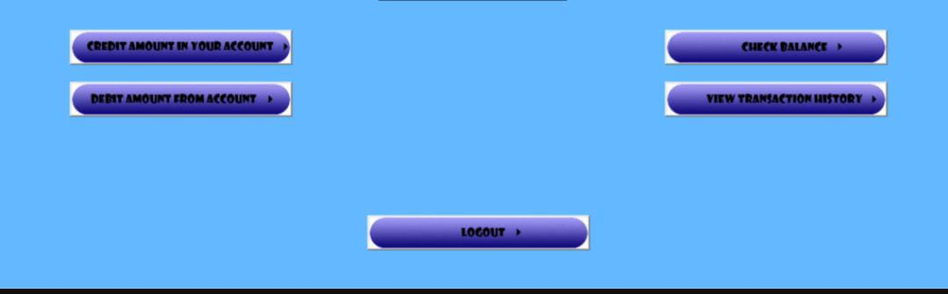

Slide 7


Slide 8
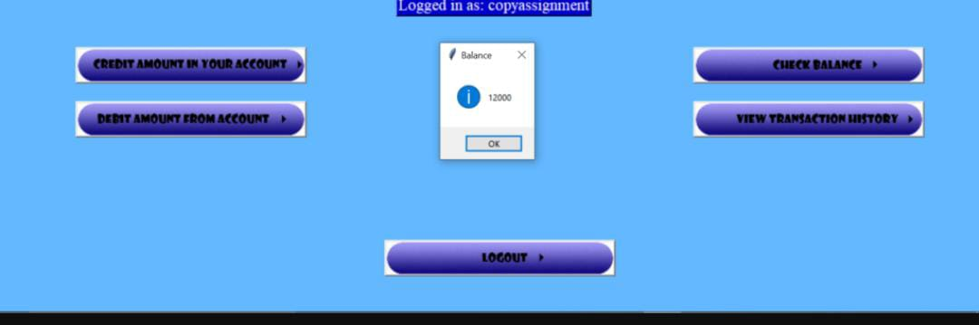

Slide 9
SUMMARY OF OUR PROJECT BANKING MANAGEMENT SYSTEM
Firstly we created Admin account and banking management system as header and added menu options available to user such as creating account, logging in or exiting the system.
Next used modules such as random and MySQL. Connector. These modules are used for generating random numbers and connecting to a MySQL database
We defined a class called Account. This class represents a bank account and has attributes such as account number, account type, name, address, KYC information, mobile number, email address, and balance.
We defined another class called Bank. This class represents a bank and has a list of accounts as one of its attributes.
We defined two more classes: User and Admin. Both classes inherit from the User class. The User class represents a regular user of the bank system and has attributes for username and password.
And we also defined two helper functions: create tables and create_admin_user.
We also generated code a login function that prompts the user to enter a username and password.
Finally, the Bank object, bank, is created along with an admin user and a regular user

Slide 10


